Slide 1

CSE 464 : Software Quality Assurance and Testing
Structural (code-based) Based Testing I
Janaka Balasooriya

Slide 2
What We Have Discussed So Far?
All the testing techniques that we have discussed so far are based on either inputs, outputs, or the behavior of the software.
It is quite likely, many defects are hidden in the software after applying some of above testing techniques as needed.
Experimental results show that code based (structural testing) can achieve the practical testable limit .
Software Under
Test
Behavior
Inputs
Outputs

Slide 3





Color of Apples…
Red
Green
Yellow
When an apple is peeled off its white
If we cut an apple into half we can see seeds
??
?

Slide 4
What is Code Based Testing ?
Simply put, code based testing involves developing test cases and testing the software system based on the code.
Thus, the tester has access to the code and knowledgeable about the programming language used to develop the software.
Code based testing focus on covering the code in various angles. We call is test coverage.
Code Based Testing Strategies:
Statement coverage
Basic path testing (Control flow coverage)
Decision-to-Decision testing
Dataflow coverage
Condition testing
Code based risk assessments (complexity of the code, object oriented matrices …etc)
Most of these testing techniques see the program as a graph.
int X=0, Y=10;
if(X>0)
X = X + Y;
else
X = X – Y;
cout<<X;

Slide 5
Program as a Graph
Given a program written in an imperative programming language, its program graph is a directed graph in which…
nodes are either entire statements or fragments of a statement, and edges represent flow of control (there is an edge from node i to node j iff the statement (fragment) corresponding to node j can be executed immediately after the statement or statement fragment corresponding to node i)
int X=0, Y=10;
if(X>0)
X = X + Y;
else
X = X – Y;
cout<<X;

Slide 6
Graph Theory – Introduction of Basic Terms

Slide 7
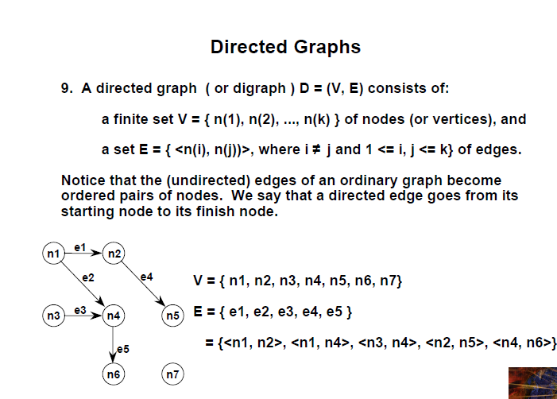

Slide 8
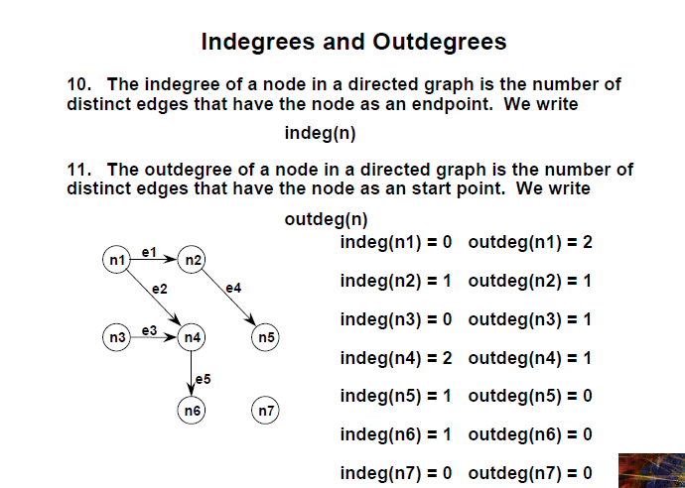

Slide 9
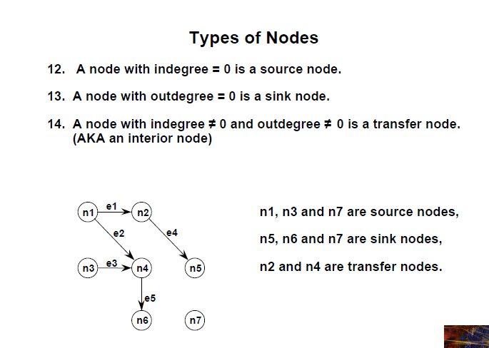

Slide 10
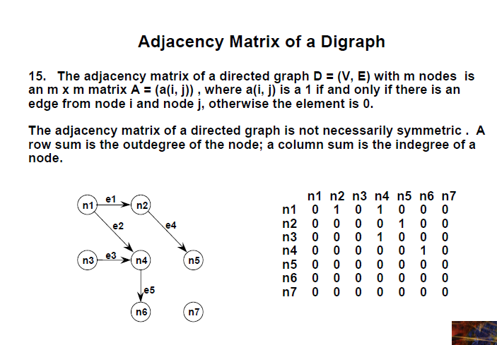

Slide 11
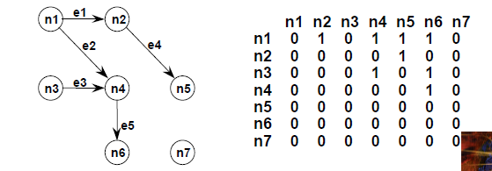
Reachability Matrix
18. The reachability matrix of a directed graph D = (V, E) with m nodes is an m x m matrix R = (r(i, j)) , where r(i, j) is a 1 if and only if there is a true path from node i and node j, otherwise the element is 0.

Slide 12
Cyclomatic Number of a Graph
Here, V(G) is 3
Cyclomatic Number V(G) of a graph is equal to number of simple decision nodes + 1

Slide 13
Program Graphs of Structured Programming Constructs
Develop graph structures for following fundamental constructs
Sequence
Pre-test Loop
Post-test Loop
If-Then
If-Then-Else
Switch-Case

Slide 14
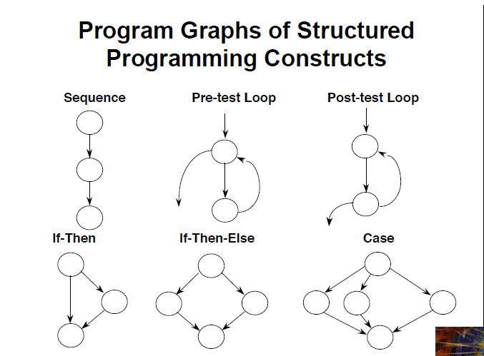

Slide 15
Control Flow Graphs - Activity

